Slide 1
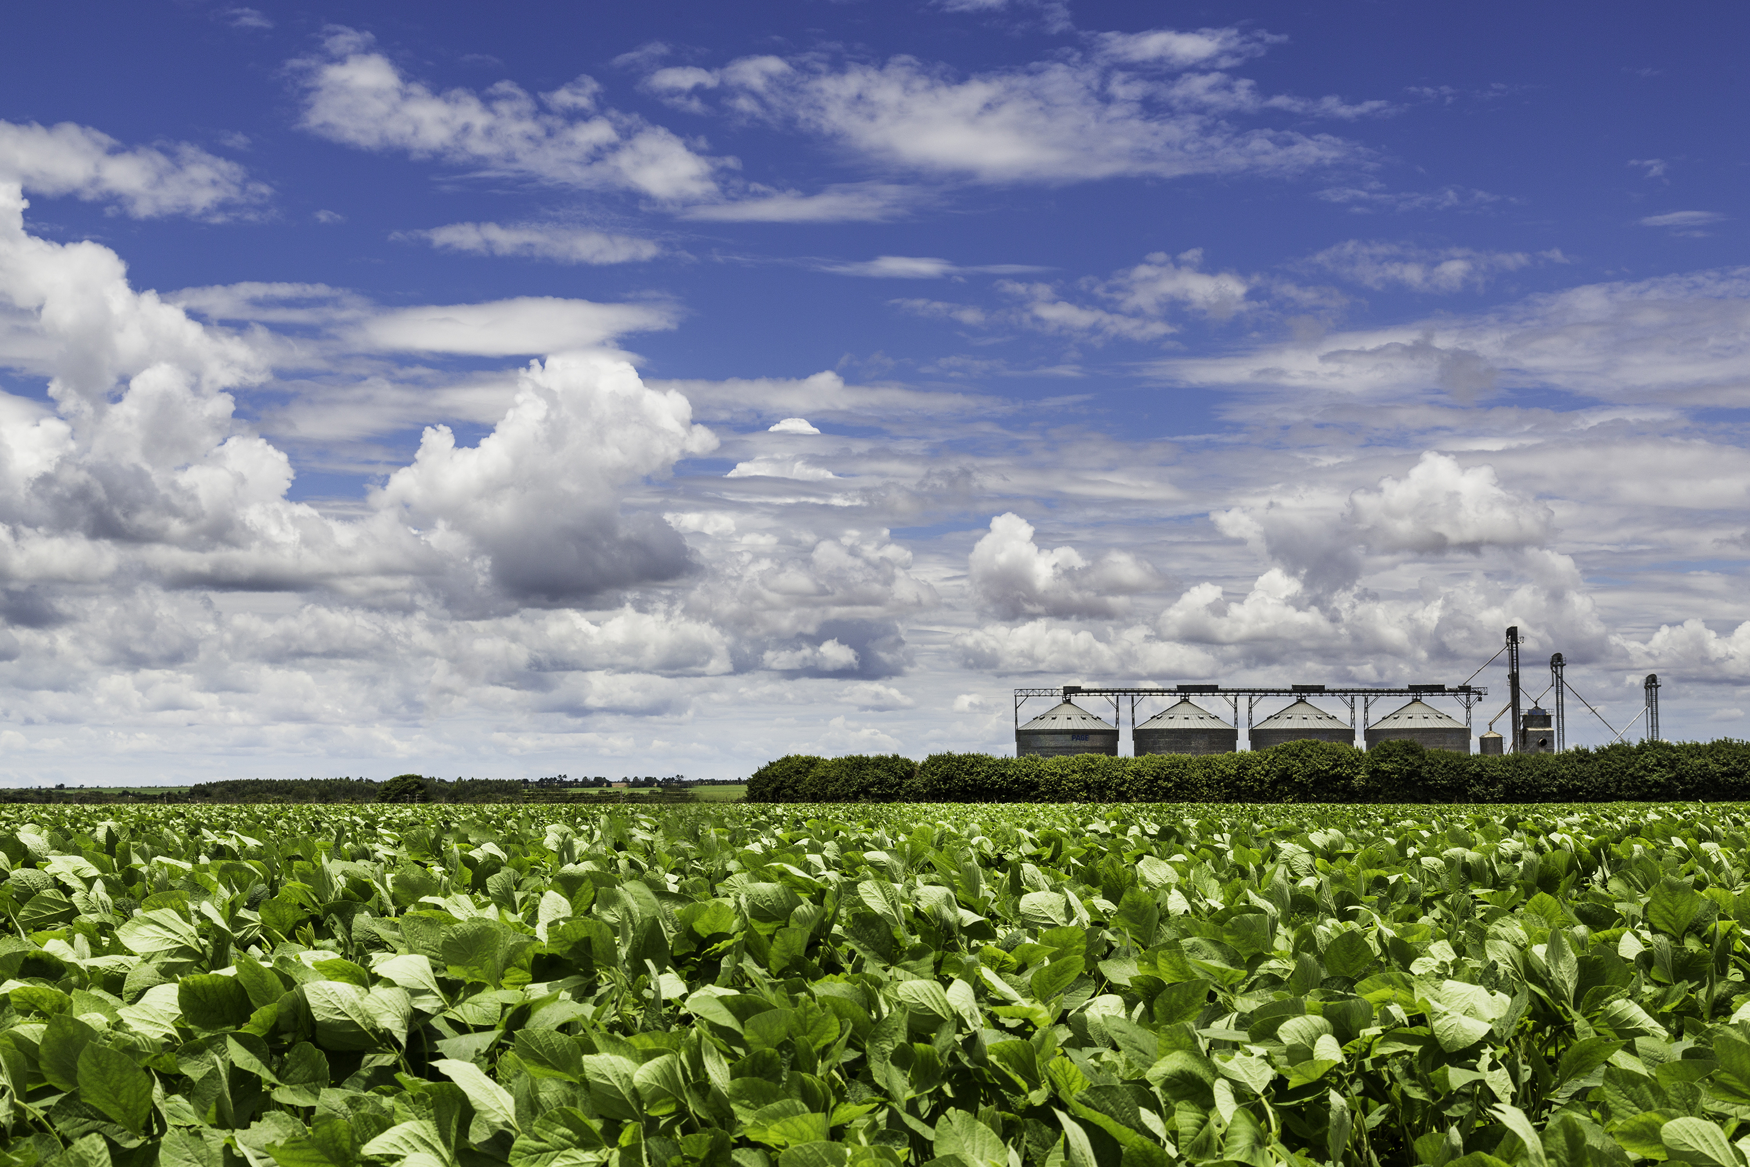
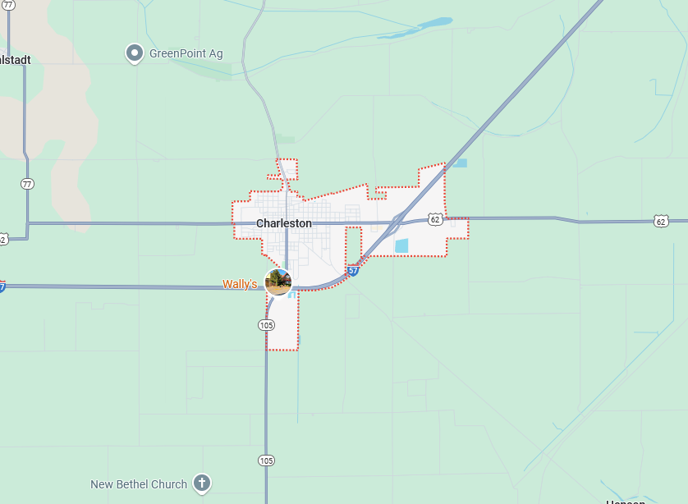
Charleston, Mississippi County, MO
Average Annual Precipitation:
36.05”
Drought Frequency:
65% of the time
High-Impact Drought Frequency:
20% of the time
Most Common Onset Season:
Summer
Most Common Relief Season:
Spring
Average Drought Length:
15 Months
Average High-Impact Drought Length:
6 Months
Longest Drought:
30 Months

